Slide 1

Fake News Detection on Social Media
Group - 18
Deepak Mallampati - dmallamp@kent.edu
Manogna Reddy Voladri - mvoladri@kent.edu
Sriya Kotu - skotu@kent.edu

Slide 2
Introduction
Rapid spread of information on social media has led to an increase in spread of fake news.
To tackle this, detecting fake news is essential to maintain integrity of online information and preventing its harmful effects.
Researchers are using tools like language processing, machine learning, and network analysis to build systems that can detect fake news.
This could be challenging because this will involve evolution of nature of fake news and this will also need a real time, accurate detection methods.

Slide 3
Problem Statement
Fake news on social media can mislead and confuse people.
Manually identifying fake news can be time consuming and also can lead to errors because we must deal with shear amount of data.
Existing tools being used to detect fake news need improvement to be more accurate and reliable.
To tackle this, building efficient and scalable techniques to detect fake news is crucial for maintaining trust and credibility in online content.

Slide 4
Tools used
Development Environment: Google Colab
Programming language: Python
Libraries used:
Numpy
Pandas
Seaborn
Matplot
Keras

Slide 5
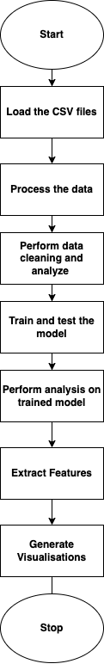
Workflow

Slide 6
Data collection
Identifying relevant Sources: We must determine the platforms where fake news is likely to be shared. For example, Twitter, Facebook, news blogs and blogs.
Search queries: Developing keywords or queries related to fake news topics to retrieve relevant data. For example, keywords may include “fake news” or “hoax” or any misleading terms.
Web scraping tools: Using web scraping tools or APIs to gather information from relevant platforms. This will involve extracting images, text, URLs and metadata from social media posts.
Implementing data filters: Removal of irrelevant or duplicate data using filters and focus on the data that is most likely to have fake news. Filters may include language, date, and content.
Store and manage data: A data storage to manage and organise the collected data while ensuring data privacy and security.

Slide 7
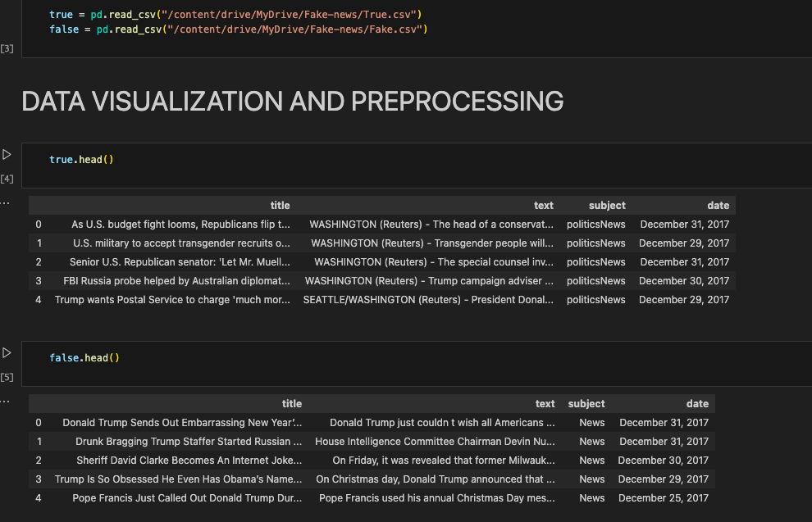
Dataset Description
Datasets used: True.csv and Fake.csv are the two datasets that we have used in this study.
Attributes:
Title
Text
Subject(Categories)
Date

Slide 8

Data Visualisation and preprocessing
Stopwords:
Stopwords are some common words that are often filtered out during text processing to increase the efficiency of natural language processing in tasks like text analysis, which we are using in here.
These words have little to no significance in analysing the text.
For example, words like an, the, a, with for etc are few of the stopwords.
Data cleaning:
It is a crucial process that should be performed before analysing and modeling.
This step will make sure that it is suitable, accurate and consistent for performing further processing.
In our project, we worked on removing html tags, removing square brackets, removing URL’s, removing stopwords.

Slide 9
Data Analysis
Summary Statistics: We calculated the basic statistics like word count, word length, to understand the characteristics of the text data.
Tokenizing text: To represent each word by a number to prepare it for further analysis.
Machine learning Modeling: Building and training the machine learning models. We have used neural network model in our study. This is used to study and classify data to be true or fake.
Evaluation and Validation: Divide the dataset into training and testing sets to evaluate the model’s performance.
GloVe embeddings: We used GloVe embeddings in natural language processing tasks which involves pre-trained word vectors to represent words in continuous vector space. They capture semantic relationships between words based on their occurrence in the large form of data.

Slide 10
Visualisation techniques
To communicate the complex information effectively in terms of accuracy, we make use of some visual aids.
Word cloud: It is one of the visualisation techniques used to display words from text data, where the size of each word represents the frequency of its occurrence, also based on its importance in the dataset.
Bar graph: It is used to represent categorical data. Each bar’s length represents the value if specific category.
Distplot: This type of visualisation technique combines histogram with kernel density estimate(KDE) plot to display the distribution of continuous variable.
Unigrams, Bigrams, Trigrams: These are terms used in natural language processing to refer to sequence of word varying lengths within text corpus.

Slide 11
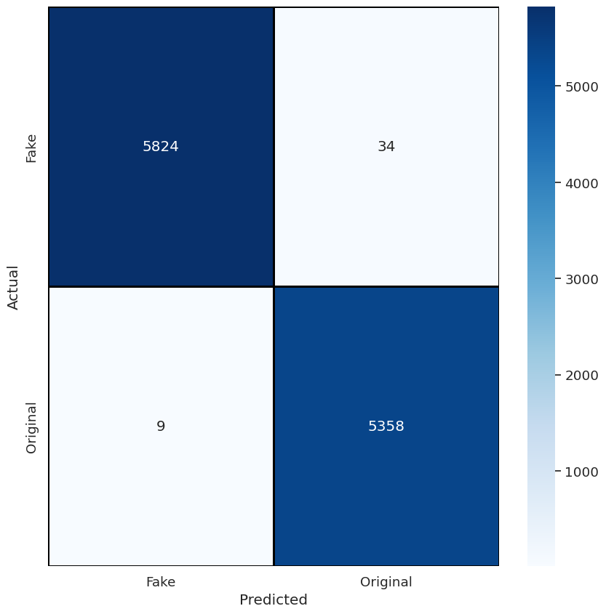
Results

Slide 12
Challenges
Diverse forms of fake news: There could be various forms, including misleading headlines, forged stories, manipulated images or videos, and misleading quotes. Detecting these diverse forms of information require beyond traditional analysis techniques.
Vast amount of data: Social media is a platform containing shear amount of information and dealing with this huge data can be difficult to perform analysis.
Contextual ambiguity: It might be challenging to differentiate a satire, an opinion and factual information.
Real time detection and response: There is a need for real time updates on the news and to respond to the created fake news.
Rapid increase in fake news tactics: Misinformation tactics continuously evolve, which may adapt to traditional or existing analysis models.

Slide 13
Conclusion
Fake news detection is a challenging task in the current era of easy spread of misinformation. This is having a significant effect on the society. Overcoming these challenges requires an all-rounded approach combining advanced technologies, data driven methods.
We have developed a high accuracy fake news detection system with NLP using glove embeddings, to provide insights on the kinds of fake news that is being spread.

Slide 14
Future Scope
Advanced Machine learning techniques: Exploring various advanced machine learning techniques and deep learning methods, including neural networks.
Contextual understanding: Including cultural factors for getting accurate results.
Multimode analysis: Incorporating analysis of textual, voice and audio content to detect various kinds of data.

Slide 15
Thank you

